Slide 1
Introduction to Compressive Sensing Aswin Sankaranarayanan

Slide 2
system
Is this system linear ?

Slide 3
system
Is this system linear ?
Given y, can we recovery x ?

Slide 4



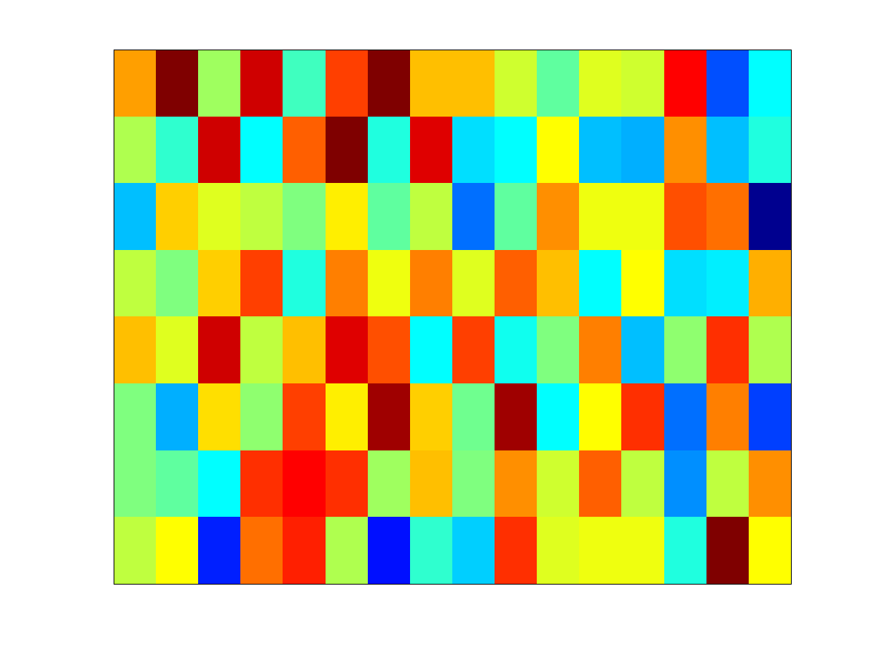




Under-determined problems
measurements
signal
measurement matrix
If M < N, then the system is information lossy

Slide 5

Image credit
Graeme Pope

Slide 6

Image credit Sarah Bradford

Slide 7


Super-resolution
Can we increase the resolution of this image ?
(Link: Depixelizing pixel art)

Slide 8
Under-determined problems
measurements
signal
measurement matrix
Fewer knowns than unknowns!

Slide 9
Under-determined problems
measurements
signal
measurement matrix
Fewer knowns than unknowns!
An infinite number of solutions to such problems

Slide 10

Credit: Rob Fergus and Antonio Torralba

Slide 11
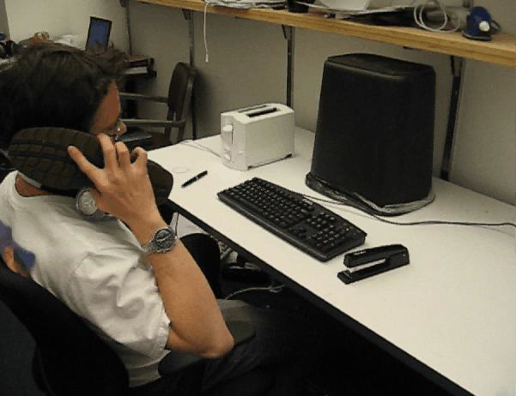
Credit: Rob Fergus and Antonio Torralba

Slide 12


Slide 13
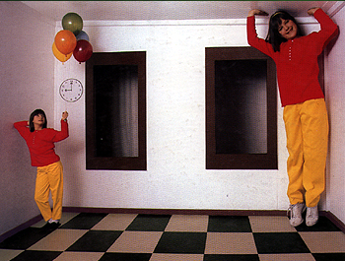
Ames Room

Slide 14
Is there anything we can do about this ?
Notes:
To answer this question, let’s consider the challenges that these cameras face.

Slide 15
Complete the sentences
Bksh – th mn, th myth, th lgnd
Gv m frdm, r gv m dth
Hy, I m slvng n ndr-dtrmnd lnr systm.
how: ?

Slide 16
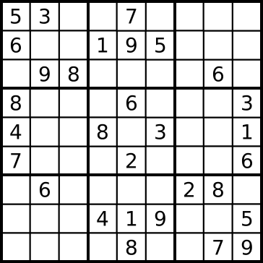
Complete the matrix
how: ?

Slide 17
Complete the image
Model ?
Notes:
An image in which i have thrown away a large % of the pixels
Is this any different from the sudoku problem ?

Slide 18
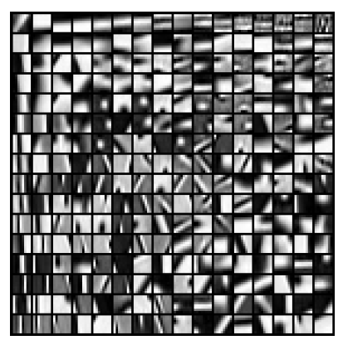

Dictionary of visual words
I cnt blv I m bl t rd ths sntnc.
Shrlck s th vc f th drgn
Hy, I m slvng n ndr-dtrmnd lnr systm.

Slide 19
Dictionary of visual words

Slide 20
Image credit
Graeme Pope

Slide 21

Image credit
Graeme Pope
Result
Studer, Baraniuk, ACHA 2012

Slide 22
Compressive Sensing
measurements
signal
measurement matrix
A toolset to solve under-determined systems by exploiting additional structure/models on the signal we are trying to recover.

Slide 23
Key Theoretical Ideas in Compressive Sensing

Slide 24
Linear Inverse Problems
Many classic problems in computer can be posed as linear inverse problems
Notation
Signal of interest
Observations
Measurement model
Problem definition: given , recover
measurement matrix
measurement noise

Slide 25


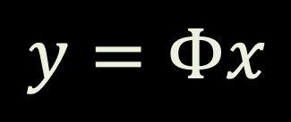


Linear Inverse Problems
$$y=Φx$$
$$y$$
$$Φ$$
$$x$$
M measurements
N-dim signal
$$M×N$$
Measurement matrix has a (N-M) dimensional null-space
Solution is no longer unique

Slide 26
Sparse Signals
$$y=Φx$$
$$y$$
$$Φ$$
$$x$$
M measurements
N-dim signal
K nonzero
entries
$$M×N$$

Slide 27




How Can It Work?
$$y$$
$$Φ$$
$$x$$
Matrix $Φ$ not full rank… $M<N$ … and so loses information in general
But we are only interested in recovering sparse signals

Slide 28
Two Key Ideas
Idea 1 --- An invertible mapping on the space of sparse signals!!!

Slide 29







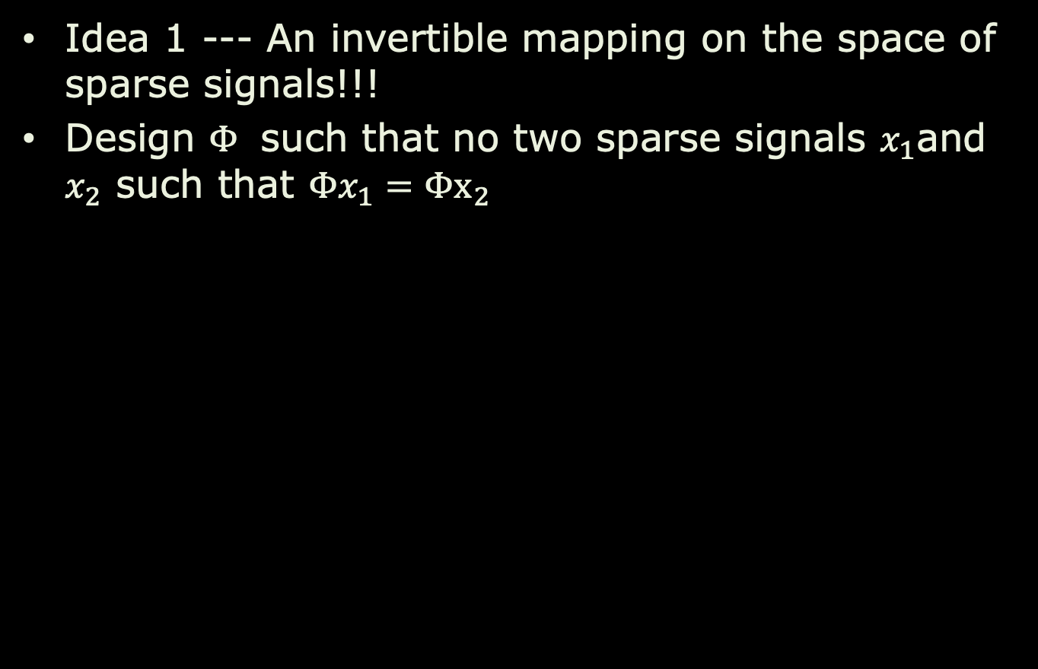
Two Key Ideas
Idea 1 --- An invertible mapping on the space of sparse signals!!!
Design $Φ$ such that no two sparse signals $x_{1}$and $x_{2}$ such that $Φx_{1}=Φx_{2}$
K-dim subspaces

Slide 30
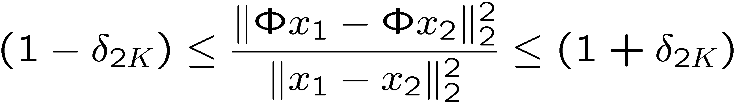
Restricted Isometry Property (RIP)
RIP of order 2K implies: for all K-sparse x₁ and x₂
K-dim subspaces

Slide 31


How Can It Work?
$$y$$
$$Φ$$
$$x$$
Matrix $Φ$ not full rank… $M<N$ … and so loses information in general
Design $Φ$ so that each of its Mx2K submatrices are full rank (RIP)

Slide 32

How Can It Work?
$$y$$
$$Φ$$
$$x$$
Matrix $Φ$ not full rank… $M<N$ … and so loses information in general
Design $Φ$ so that each of its Mx2K submatrices are full rank (RIP)
Random measurements provide RIP with
$M\sim K \log{(N/K)}$

Slide 33
Two Key Ideas
Idea 1 --- An invertible mapping on the space of sparse signals!!!
Idea 2 --- Recovery of signals: use sparse priors!

Slide 34

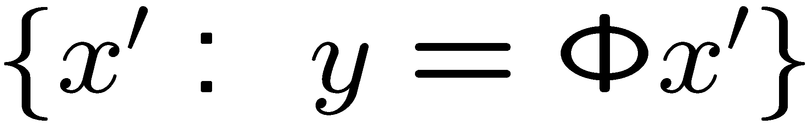

CS Signal Recovery
Random projection $Φ$ not full rank
Recovery problem: given $y=Φx$ find $x$
Null space
Search in null space for the “sparsest” $x$
(N-M)-dim hyperplane at random angle

Slide 35
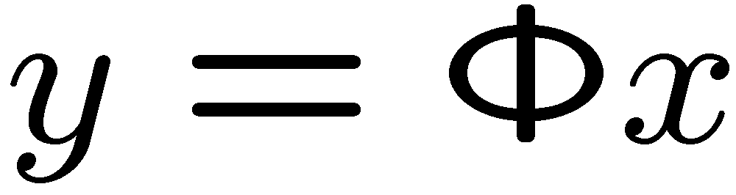
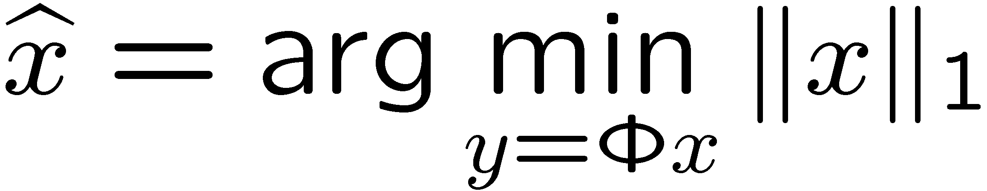

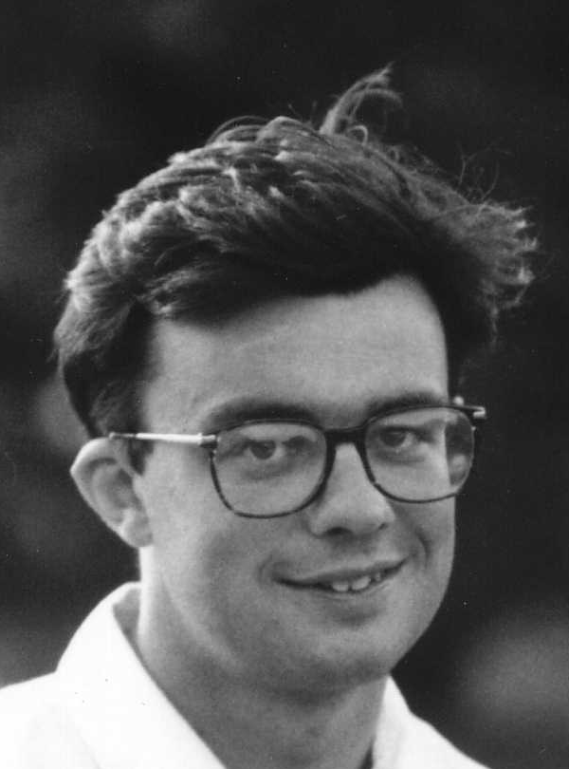

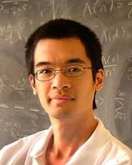
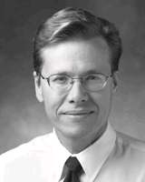

$ℓ_{1}$Signal Recovery
Recovery: given (ill-posed inverse problem) find (sparse)
Optimization:
Convexify the optimization
Candes Romberg Tao
Donoho
Notes:
35

Slide 36

$ℓ_{1}$Signal Recovery
Recovery: given (ill-posed inverse problem) find (sparse)
Optimization:
Convexify the optimization
Polynomial time alg (linear programming)
Notes:
36

Slide 37
Compressive Sensing
Let.
If satisfies RIP with ,
Then
Best K-sparse approximation
Notes:
37

Slide 38
modern sensors are linear systems!!!

Slide 39
Sampling
sampling
Can we recover the analog signal from its discrete time samples ?

Slide 40
Nyquist Theorem
An analog signal can be reconstructed perfectly from discrete samples provided you sample it densely.

Slide 41
The Nyquist Recipe
sample faster
sample denser
the more you sample,
the more detail is preserved

Slide 42
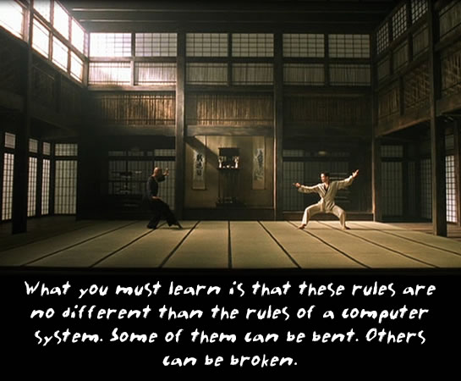

Slide 43
The Nyquist Recipe
sample faster
sample denser
the more you sample,
the more detail is preserved
But what happens if you do not follow the Nyquist recipe ?

Slide 44
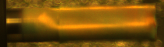
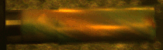
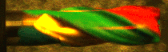
Breaking resolution barriers
Observing a 2000 fps spinning tool with a 25 fps camera
Normal Video: 25fps
Compressively obtained video: 25fps
Recovered Video: 2000fps
Slide/Image credit: Reddy et al. 2011

Slide 45
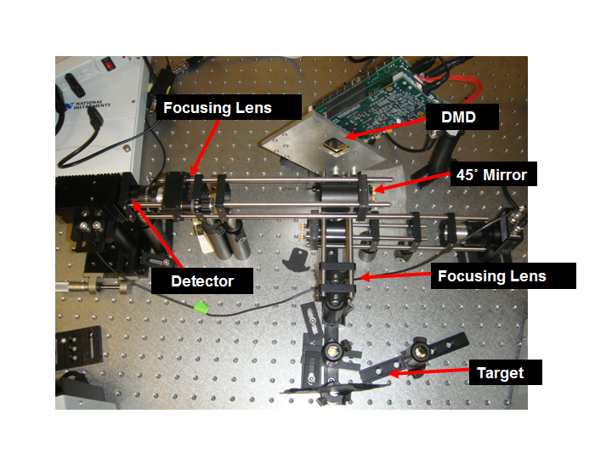
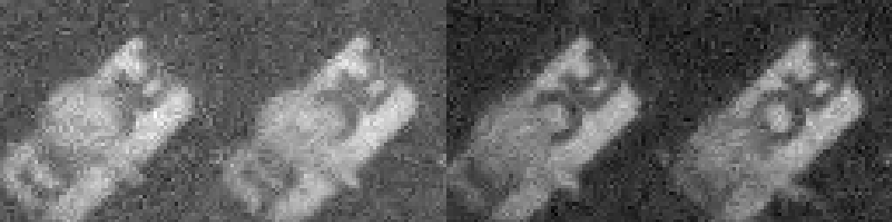
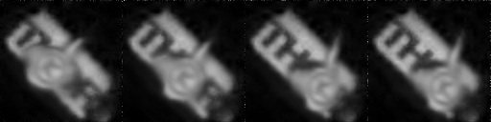
Compressive Sensing
Use of motion flow-models in the context of compressive video recovery
128x128 images sensed at 61x comp.
Naïve frame-to-frame recovery
single pixel camera
CS-MUVI at 61x compression
Sankaranarayanan et al. ICCP 2012, SIAM J. Imaging Sciences, 2015*

Slide 46
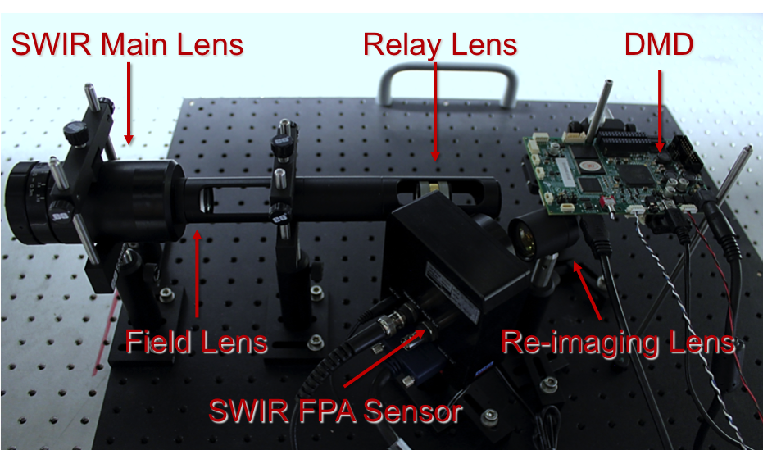
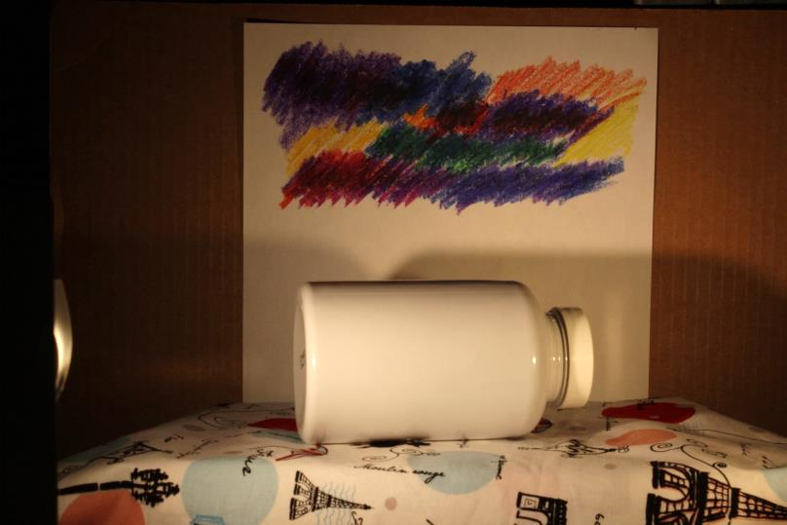
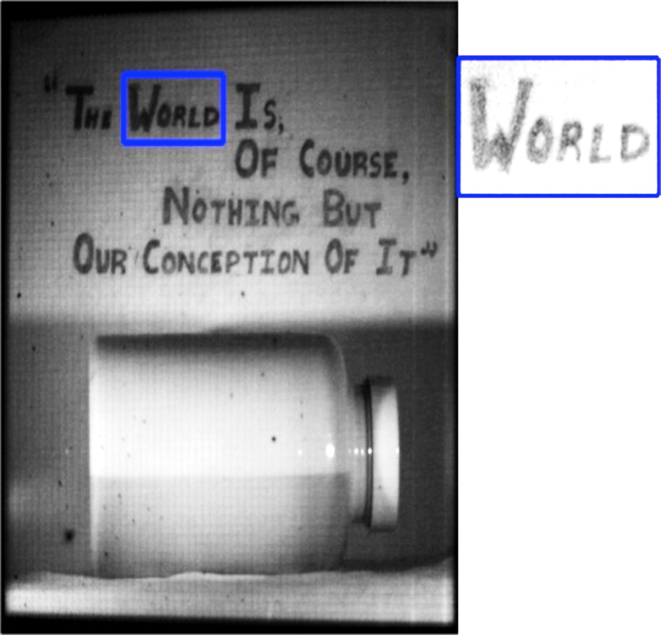
Compressive Imaging Architectures
Scalable imaging architectures that deliver
videos at mega-pixel resolutions in infrared
visible image
SWIR image
A mega-pixel image obtained from a 64x64 pixel array sensor
Chen et al. CVPR 2015, Wang et al. ICCP 2015

